Slide 1




?
WHY?
PROCESS
SENSORS
BOARDS
TEAMS

Slide 2
SMART
?
WHY?
PROCESS
SENSORS
BOARDS
TEAMS
METERING
DIGITALENT SCHOLARSHIP BATCH II 2019
UNIVERSITAS HASANUDDIN

Slide 3
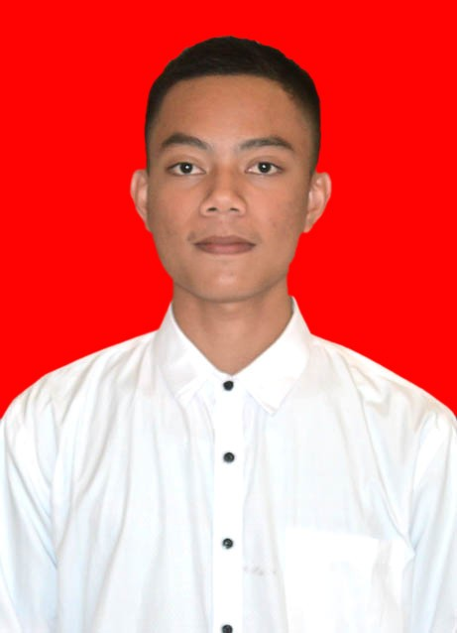
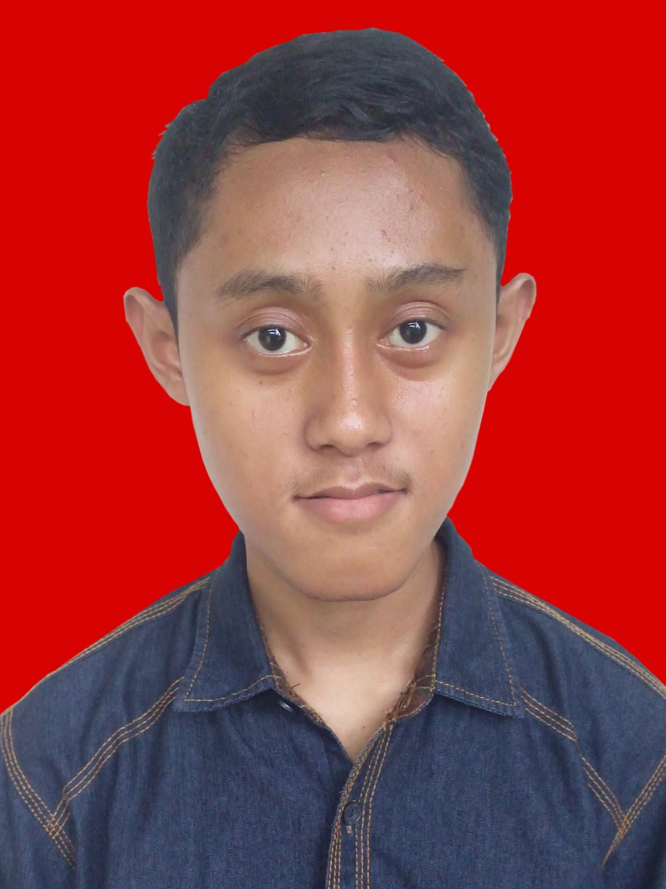
?
SENSORS
WHY?
PROCESS
BOARDS
TEAMS
MUH KHAERIL SYAM
SABTIAN JULIANA
TEKNIK INFORMATIKA
TEKNIK INFORMATIKA
UNIVERSITAS HASANUDDIN
UNIVERSITAS HASANUDDIN

Slide 4

WHAT IS THE
PROBLEM
?
WHY?
PROCESS
SENSORS
BOARDS
TEAMS

Slide 5

IT CAN BE
OVERCOME
?
WHY?
PROCESS
SENSORS
BOARDS
TEAMS
WITH
IoT

Slide 6
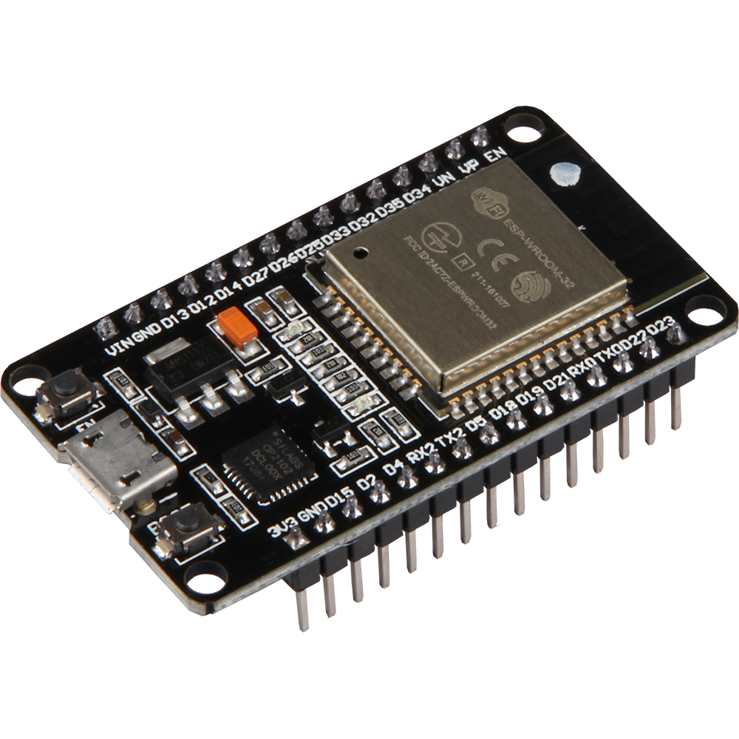
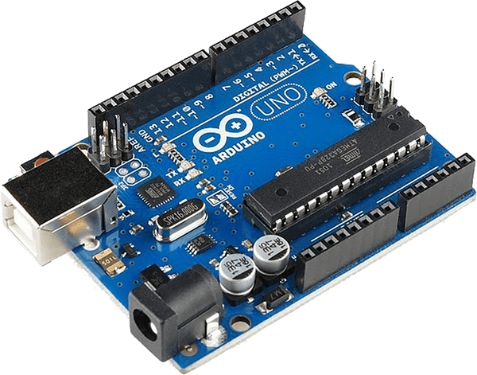
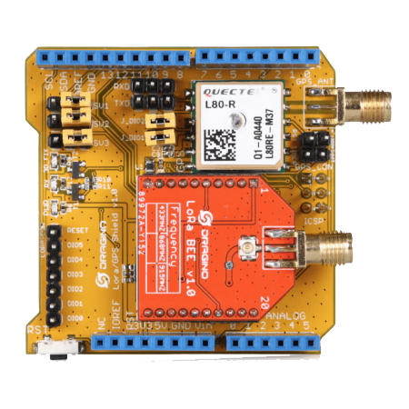
1
2
3
ARDUINO
UNO
LoRa
DRAGINO
Esp32
?
WHY?
PROCESS
SENSORS
BOARDS
TEAMS

Slide 7
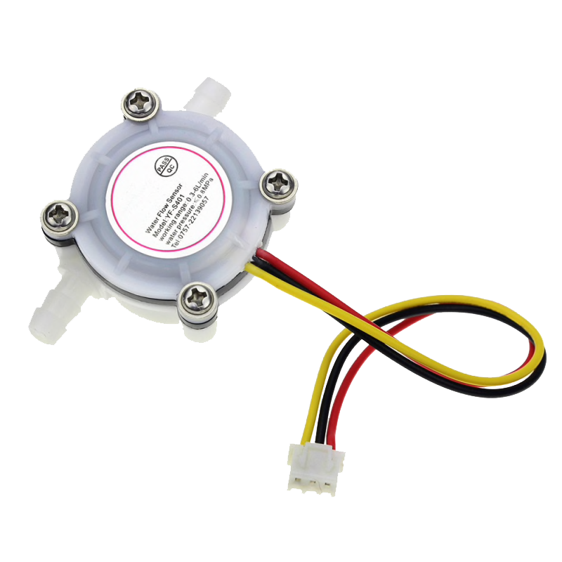
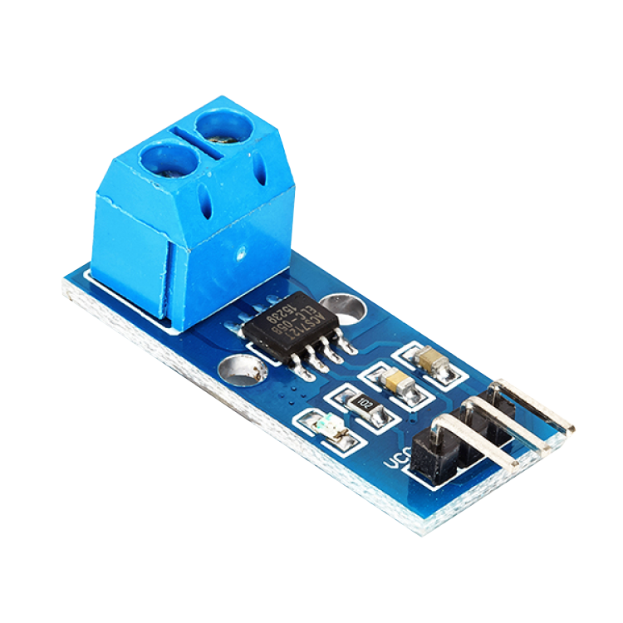
1
2
WATER
FLOW
ACS 712
?
WHY?
PROCESS
SENSORS
BOARDS
TEAMS

Slide 8





?
PROCESS
WHY?
SENSORS
BOARDS
TEAMS

Slide 9


ANY QUESTION ?
?
WHY?
PROCESS
SENSORS
BOARDS
TEAMS

